Slide 1

6th Grade Accelerated Math
Unit 8, Lesson 4 Nets of Rectangular Prisms and Pyramids Volume 2, pg. 20

Slide 2


Benchmark
MA.6.GR.2.4
Given a mathematical or real-world context, find the surface area of right rectangular prisms and right rectangular pyramids using the figure’s net.
volume 2, pg. 20

Slide 3
Integrated Mathematical Thinking and Reasoning Standards
MA.K12.MTR.1.1 Actively participate in effortful learning both individually and collectively.
MA.K12.MTR.2.1 Demonstrate understanding by representing problems in multiple ways.
MA.K12.MTR.4.1 Engage in discussions that reflect on the mathematical thinking of self and others.
MA.K12.MTR.5.1 Use patterns and structure to help understand and connect mathematical concepts.
volume 2, pg. 20

Slide 4

Learning Targets
I can draw the net of a rectangular prism or rectangular pyramid.
I can relate a net to its three-dimensional shape.
I can relate a rectangular prism or rectangular pyramid to its net.
volume 2, pg. 20

Slide 5

Warm-Up
volume 2, pg. 21

Slide 6
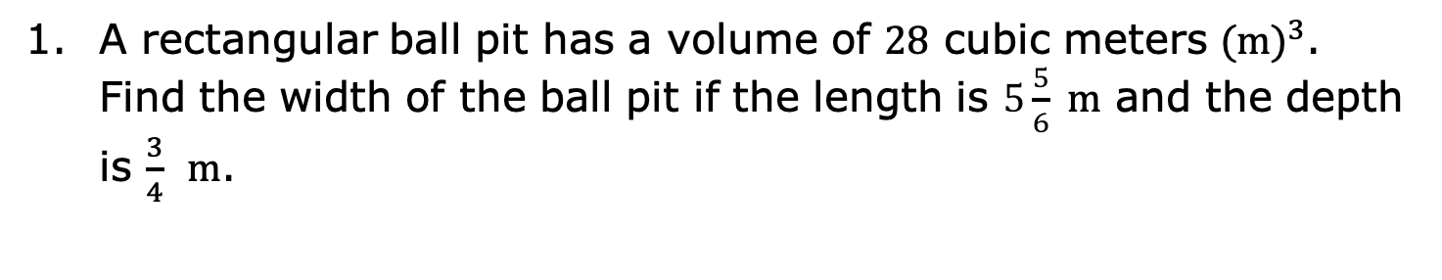
8.4.1 Warm-Up: Bell Work
A rectangular ball pit has a volume of 28 cubic meters ${(m)}^{3}$. Find the width of the ball pit if the length is $5\frac{5}{6}$m and the depth is $\frac{3}{4}$ m.
volume 2, pg. 21

Slide 7

Refresher
volume 2, pg. 21

Slide 8

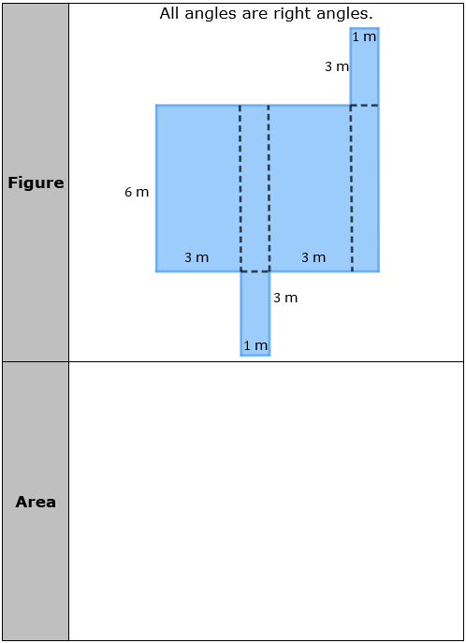
8.4.2 Refresher: Area of Composite Figures
Work with your partner to find the area of each composite figure. All measurements are in meters (m).
volume 2, pg. 21

Slide 9
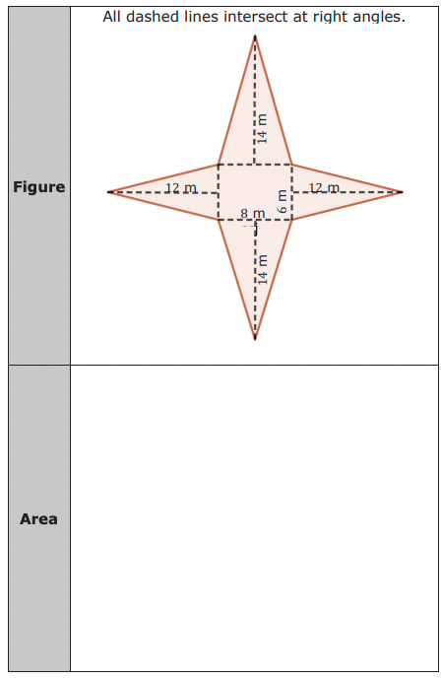
volume 2, pg. 22

Slide 10

Exploration
volume 2, pg. 21

Slide 11


8.4.3 Exploration: Creating Three-Dimensional Figures
Both composite figures in the previous component are nets. A net is formed when the faces of a three-dimensional figure are positioned by arranging the faces to create a two-dimensional composite figure.
volume 2, pg. 22

Slide 12
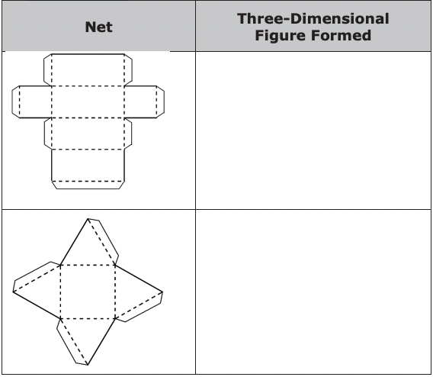
Your teacher will provide you with copies of some nets. Cut the nets along the solid line. Fold the nets along the dotted line and use the tabs to glue the figure together.
Complete the table to describe the three-dimensional figure formed.
volume 2, pg. 22

Slide 13
Look back at the two composite figures from the refresher. Predict what three-dimensional figure is made from cutting out and folding up the sides of those figures.
With your partner, discuss how the area of a two-dimensional composite figure is related to the area of the faces of the three-dimensional figure. Summarize your discussion.
volume 2, pg. 23

Slide 14

Collaboration
volume 2, pg. 23

Slide 15

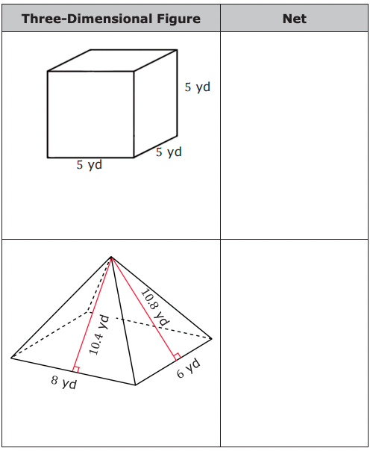
8.4.4 Collaboration: Determining Nets
1. With your partner, sketch the net or sketch the individual faces of the three-dimensional figure. Label each side of the net with the appropriate measurement in yards (yd).
volume 2, pg. 23

Slide 16

Wrap-Up
volume 2, pg. 24

Slide 17
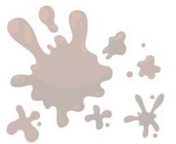
8.4.5 Wrap-Up: Reflection
1. What was the muddiest (most difficult or confusing) point in today’s lesson on nets?
volume 2, pg. 24

